Slide 1
Modeling Soot Formation from Solid Complex Fuels
Alexander J. Josephson^{1,2}
Emily Hopkins²
Rod R. Linn²
David O. Lignell¹
¹Department of Chemical Engineering, Brigham Young University, Provo, Utah
²Earth and Environmental Sciences Division, Los Alamos National Lab, Los Alamos, New Mexico
Western States Section of the Combustion Institute Fall Technical Meeting 2017
University of Wyoming, Laramie, Wyoming
October 2-3, 2017

Slide 2




Acknowledgements/Background
Work began as part of the CCMSC’s PSAAP II project
  Demonstrate exascale computing with V&V/UQ to more rapidly deploy new technologies for providing low cost, low emission electric power generation
  Full-scale simulation of an oxy-coal boiler
  Work supported by the Department of Energy, National Nuclear Security Administration, under Award Number(s) DE-NA0002375
Work continued through the EES division at LANL
  HIGRAD/FIRETEC- combines physics models that represent combustion, heat transfer, aerodynamic drag and turbulence. Designed to simulate the constantly changing, interactive relationship between fire and its environment.
  Predicting solid particle emissions from wildfires
  Work support comes from a large variety of sources: US Forest Service, Department of Energy, Department of Defense, and others

Slide 3
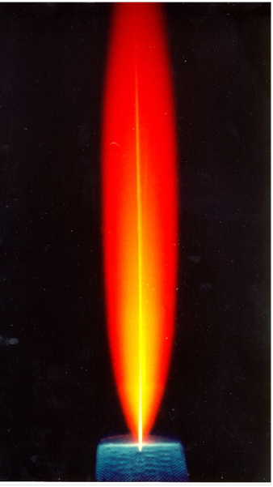
Soot Introduction
Soot
      Particles heavily impact radiative heat transfer
      Changes flame chemistry
      Health and environmental impacts
Basic Formation
Rate-determining step is usually the formation of soot precursors
Morphology and yield of soot particles largely depended on particle residence time in the flame and other system configurations
Soot Precursors
Nucleation
Coagulation
Aggregation
Gas-Phase Molecules
Consumption
Growth
Growth
Gaseous Fuels
Parent fuel breaks into small gaseous species
PAH formed from gaseous mechanisms
Solid Fuels
Parent fuel gives off tar during primary pyrolysis
Tar acts as primary soot precursor

Slide 4
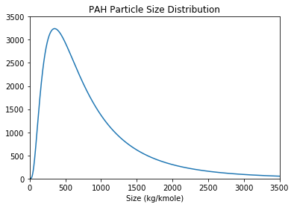
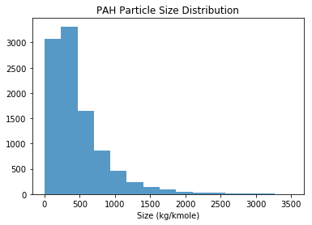
Model Overview
Precursor Molecules
Soot Particles
Transport distribution using a sectional approach
Transport soot distribution using method of moments
Transport includes source terms for:
  Soot Nucleation
  Particle Agglomeration
  Surface Reactions
Interpolative closure used to resolve fractal moments
Transport includes source terms for:
  Precursor creation
  Surface Reactions
  Thermal Cracking
  Soot Nucleation
Bin Species Number Density
PSD Moment Density

Slide 5
Particle Morphology
All soot precursors are assumed to be spherical
Soot particle average morphology is described using a ‘shape factor’ introduced by Balthasar and Frenklach (2005)
d is a scale
  d = 2/3 implies perfectly spherical particles
  d = 1 implies particles are arranged in a manner to produce the maximum possible surface area for that given mass
M_{d} is another transported moments with resolved terms for nucleation and surface reactions,
Added another term for particle agglomeration

Slide 6
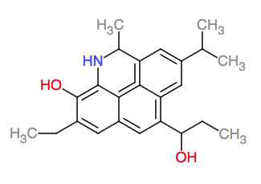
Model Details- Soot Precursors
Formation
  Release of tar
  Creation of pyrene
Coagulation (formation of a soot particle)
  Frequency of collision between molecules
Deposition (onto the surface of a soot particle)
  Frequency of collision between precursor and soot particle
Thermal Cracking
  Categorize into four types (Phenol, Toluene, Naphthalene, and Benzene)
  Type amounts based on characteristics of original fuel
  Each type cracks at a different rate (Marias 2017)
Surface Growth
  HACA (C₂H₂)
Surface Consumption
  Oxidation (O₂ and OH)
  Gasification (CO₂ and H₂O)

Slide 7
Model Details- Soot Particles
Nucleation
  Frequency of collision between precursors
Surface Growth
  HACA
  Available surface area accounted for by shape factor
Deposition
  Frequency of collision between precursor and soot particle
Agglomeration
  Frequency of collision between molecules
  Computed for both continuum and free-molecular regime
  Weighted average between regimes scaled by the Knudsen number
Surface Consumption
  Oxidation
  Gasification
  Rates based on recently published work

Slide 8
Recognized Shortcomings
Fragmentation
  Particles may split (mechanically or chemically)
Particles fully consumed
  No sink term for number of particles when fully consumed
Inorganics
  Soot particles from solid complex fuels are known to contain inorganics
  May act as catalyst for surface reactions (Na, K, S)
Notes:
Add additional slide here to detail the initial fraction estimation

Slide 9
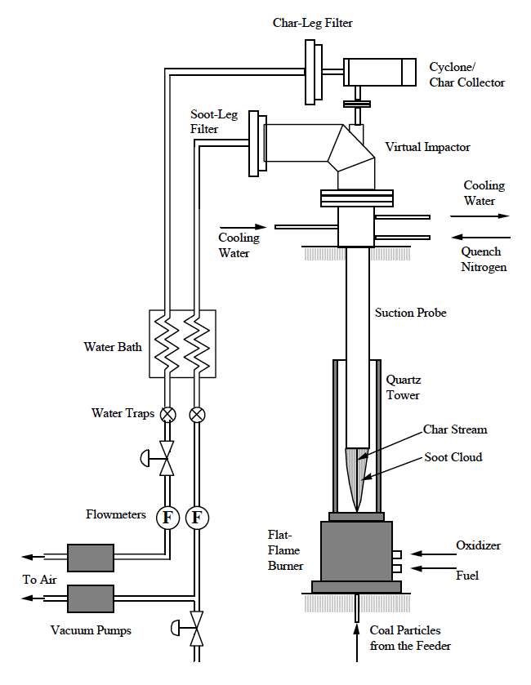
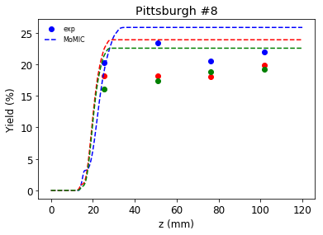
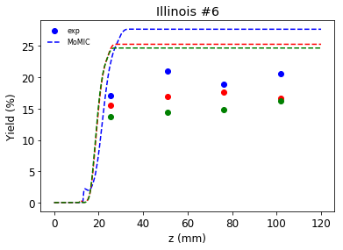
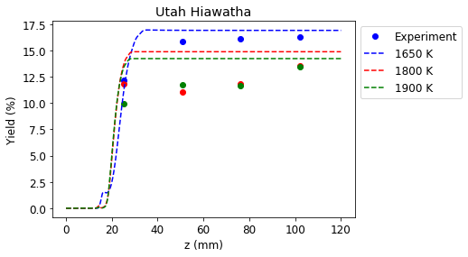
Validation- Coal System
Experiment conducted by Jinliang Ma at BYU (Ma, 1998)
Laminar flat flame burner
Separation system collects soot, char and ash particles
Equilibrium chemistry profile ABF mechanism
CPD model predicts tar
Sources of error
Notes:
Add additional slide here to detail the initial fraction estimation

Slide 10
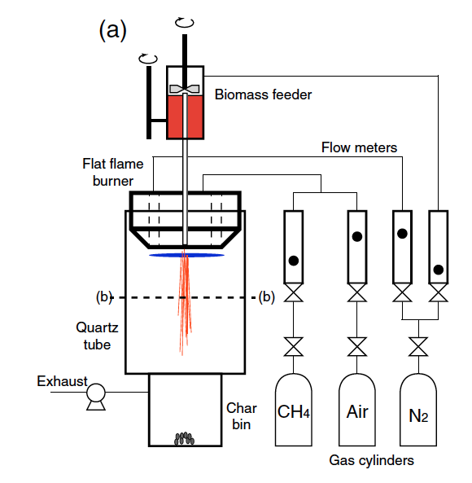
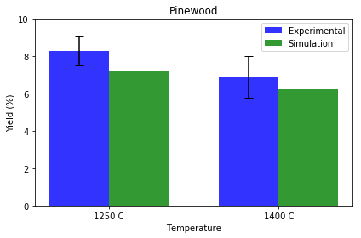
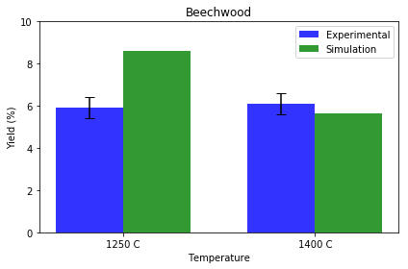
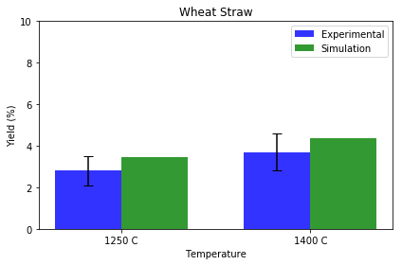
Validation- Biomass System
Experiment conducted by Trubetskaya, 2016 at Technical University of Denmark and Lulea University of Technology
Biomass gasification
Separation system collects soot, char and ash particles
Equilibrium chemistry profile ABF mechanism
CPDbio model predicts tar

Slide 11
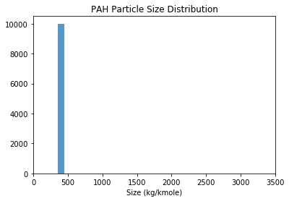
Model Adaptations- Mono-dispersed
Simplifies both distributions to mono-dispersed
  Precursor distribution assumes an average molecular size
    350 g/mole for coal systems
    450 g/mole for biomass systems
    202 g/mole for gas systems
  Soot distribution has adjustable particle size
Requires the resolution of 4 terms rather than 14+
  1 term, number density, for precursor
  3 terms, number density, mass density, and shape factor, for soot PSD
  Is the shape factor needed?
Uncertainty quantification under evaluation now
Notes:
Add another slide here separating growth from consumption

Slide 12
Sooting Potential Model
Biomass Type | Mass Yield Average | Mass Yield Variation (+/-) | Molecular Weight Average | Molecular Weight Variation
Cellulose | 47.9 | 0.5 | 460 | 5
Softwood Hemicellulose | 30.2 | 0.6 | 400 | 6
Softwood Lignin | 62.4 | 1.5 | 528 (502) | 54 (3)
Hardwood Hemicellulose | 30.5 | 0.6 | 396 | 11
Hardwood Lignin | 53.5 | 0.6 | 546 | 6
Tested tar yield of various biomass components using CPD-bio model
  Varied pressure (0.5-1.1 atm)
  Varied temperature (600 C- 3000 C)
  Varied heat-up profile (100 C/s ~ 1500 C/s)
Measured
  Total mass yield of tar
  Average molecular size of tar
No significant variation from these parameters
Does not account for extractives
We can now build a ‘sooting potential’ of our biomass based on the component make up of the fuel

Slide 13
Surrogate Model
Inputs
Fuel Type
Fuel Density
Temperature
Wind Velocity
Turbulence
Oxygen
Etc.
Outputs
Particle Number
Particle Size
Detailed Simulation
Surrogate Model
Uses detailed simulations to map inputs to outputs
Fit a simplified model to the inputs and outputs
  Simplified model may be quadratic, linear, or any number of inexpensive forms
Requires a ’basic unit’
  Wildland forest unit
  Grassland forest unit
Anytime we change the ‘basic’ unit, we must recalibrate to the new situation

Slide 14
Conclusions
Detailed soot model for complex solid fuels presented
Model evaluates evolution of two species: soot and precursors
Precursor PSD- sectional approach
Soot PSD- method of moments with interpolative closure
Validation work presented with good agreement for both coal and biomass systems
Some of the ongoing model adaptation presented

